Slide 1
Introduction to Computer Hardware (CMP213) Fabrication of Integrated Circuits
Egena Onu, PhD
Prepared by I.O. Adelaiye

Slide 2
Content
Wafer preparation
Photolithography
Etching
Thermal and Local Oxidation
Dopant Diffusion and Ion Implantation
Deposition
Patterning
Scribing and cleaving

Slide 3
Ingot Growth
First step in production of an integrated circuit is growth of a large piece of almost perfectly crystalline semiconducting material called an ingot (boule).
Small seed crystal is suspended in molten material then pulled (1m/hr) and rotated (1/2 rps) to form the ingot•
Result is an ingot approx. 1m long and anywhere from 75 to 300 mm in diameter.
Dopant is almost always added to the molten material

Slide 4
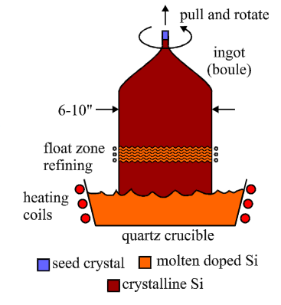
Ingot Growth 2

Slide 5
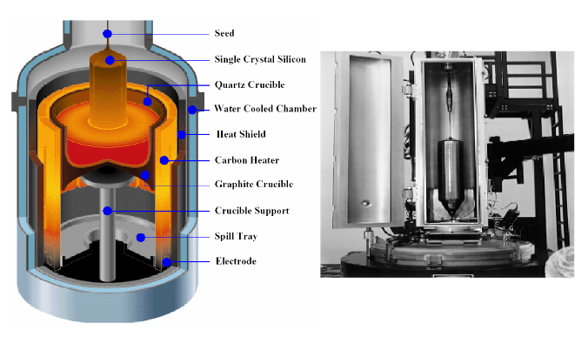
Ingot Growth

Slide 6
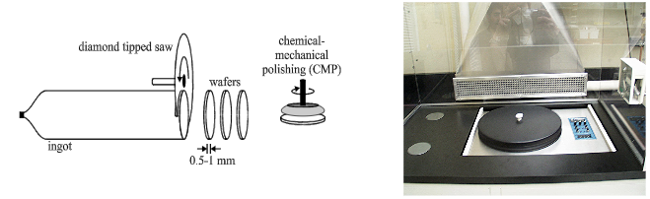
Wafer sawing
Ingots are then sawed into wafers approximately 500-1000μm (0.5 to 1 mm) thick using a diamond tipped saw
Wafers are the starting material for integrated circuit manufacture, and are normally referred to as the substrate
Surface of the wafer is smoothened with combination of chemical and mechanical polishing steps

Slide 7
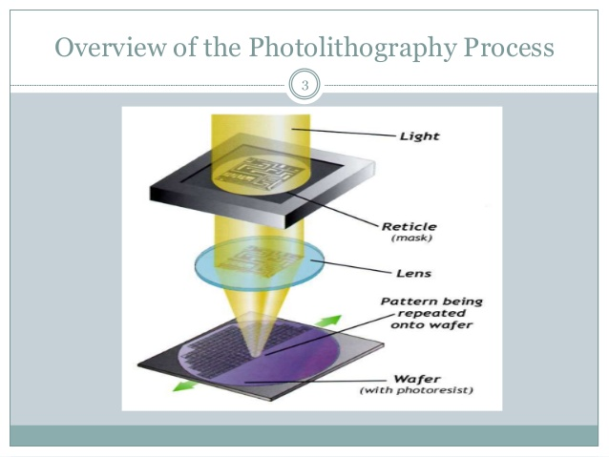
Photolithography

Slide 8
Photolithography
Lithography refers to the transfer of an image onto paper using a plate and ink-soluble grease
Photolithography is the transfer of an image using photographic techniques
Photolithography transfers designer generated information (device placement and interconnections) to an actual IC structure using masks which contain the geometrical information
The process of photolithography is repeated many times in manufacture of an IC to build up device structures and interconnections

Slide 9
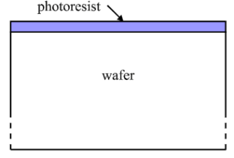
Photoresist
First step in photolithography is to coat the surface with approx 1μm of photoresist (PR)
PR will be the medium whereby the required image is transferred to the surface
PR is often applied to the center of the wafer, which is then spun to force the PR over the entire surface
Note that the scale of these diagrams is not correct - the PR is approx. 1μm thick while the wafer is 1000μm thick.
Notes:
A photosensitive resist that, when exposed to light, loses its resistance or its susceptibility to attack by an etchant or solvent. Such materials are used in making microcircuits.

Slide 10
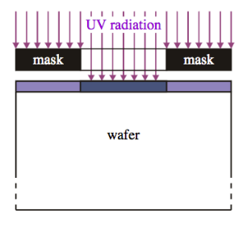
Exposure
The PR is then exposed to UV(ultraviolet) radiation through a mask
The masks generated from information about device placement and connection
The UV radiation causes a chemical change in the PR
The transfer of information from the mask to the surface occurs through the UV-induced chemical change - only occurs where the mask is transparent

Slide 11
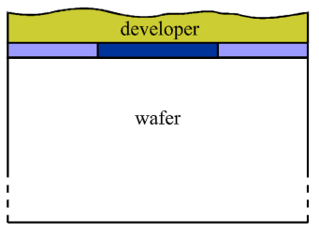
Development
The PR is then developed using a chemical developer
Two possibilities:
A negative PR is hardened against the developer by the UV radiation, and hence remains on the surface where UV shines through the mask
A positive PR which is the opposite, is removed from where the UV shone through the mask
Assume a negative PR for this illustration, so the PR on the sides will be weakened and removed by the developer

Slide 12
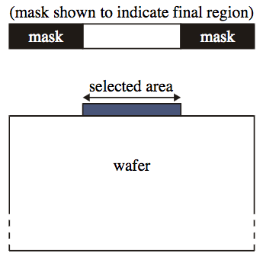
Final Structure
Once the developer has been washed off, the result is PR in the region corresponding to the transparent part of the mask (the mask is shown again to indicate where the final region is formed – it is not part of the final structure)
Subsequent processing steps will use this structure to form device areas, interconnects, etc.

Slide 13
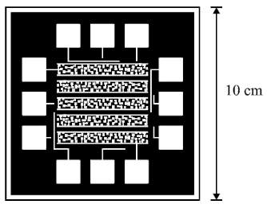
Reticle
A reticle is a photomask used for steppers and scanners (with step and repeat system) to transfer circuit pattern on wafers.
The geometric information over the entire IC required for a particular photolithography step is used to create a reticle, a 10X sized optical plate
There can be from 6 to over 24 individual photolithography steps in a manufacturing process, each with its own set of geometrical information captured in a reticle
Notes:
A stepper is a device used in the manufacture of integrated circuits (ICs) that is similar in operation to a slide projector or a photographic enlarger. Steppers are an essential part of the complex process, called photolithography.
A photomask is an opaque plate with holes or transparencies that allow light to shine through in a defined pattern.

Slide 14
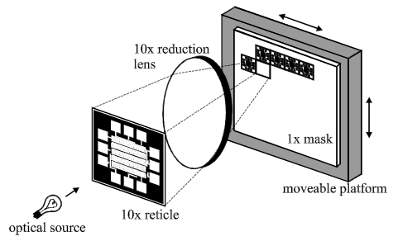
Mask Generation- Repeating steps
In order to fabricate many devices simultaneously, the reticle information is reduced and projected many times onto a 1X mask using a step and repeat process

Slide 15
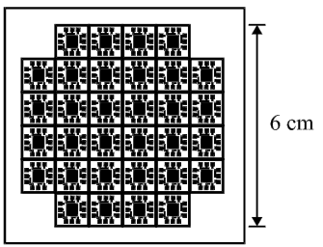
Final 1X Masks
The 1X mask which results from the step and repeat process contains all the information for a particular photolithographic step for all chips which will be fabricated on the wafer
This image is projected during the exposure step to cause PR chemical changes in the appropriate locations

Slide 16
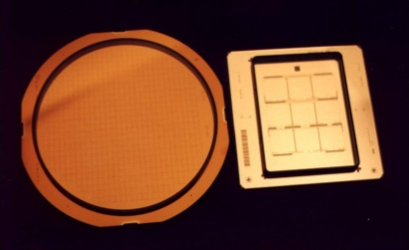
Reticle and Masks
Mask Reticle

Slide 17
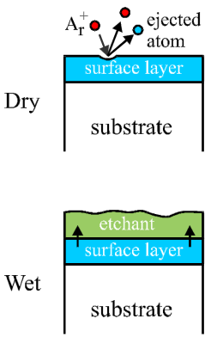
Etching
Etching is the selective removal of material from the chip surface
In dry etching, ions of a neutral material are accelerated toward the surface and cause ejection of atoms of all materials
In wet etching, a chemical etchant is used to remove material via a chemical reaction

Slide 18
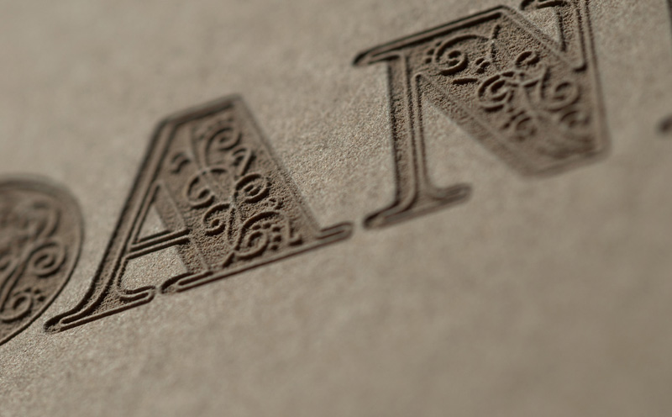
Etching

Slide 19
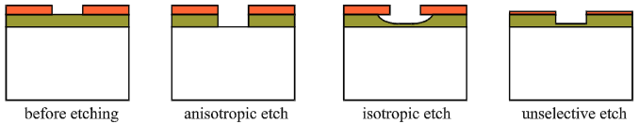
Etching
Two most important issues in etching are selectivity and isotropy
Selectivity refers to the ability of an etchant to remove one material on the surface while leaving another intact.
Isotropic refers to the tendency of the etching to proceed laterally as well as downward

Slide 20
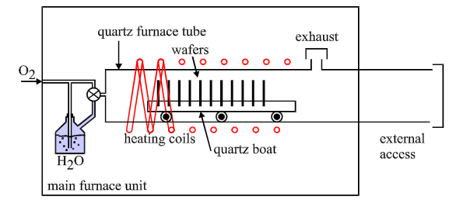
Thermal Oxidation
One of the simplest steps in IC processing is thermal oxidation, the growth of a layer of silicon dioxide (SiO₂) on the substrate surface
Requires only substrate heating to 900-1200 ºC in a dry (O₂) or wet (H₂0 steam) ambient using an oxidation furnace
Silicon oxidizes quite readily – one reason why Si is so widely used

Slide 21
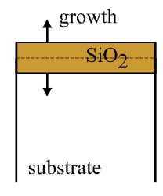
Thermal Oxidation
Oxide forms due to the chemical reaction between oxygen in the ambient and silicon in the substrate
Substrate silicon is consumed during the reaction, so oxide layer grows in both directions from the original substrate surface (approx. 50/50)

Slide 22
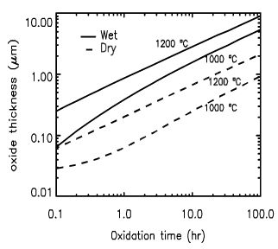
Thermal Oxidation
Due to the different reaction mechanisms, oxidation in a wet ambient is many times faster than oxidation in a dry ambient
However, the oxide quality is much better when a dry ambient is used
Thick isolation layers are therefore formed using wet oxidation, while MOSFET gate oxides are formed with dry oxidation

Slide 23
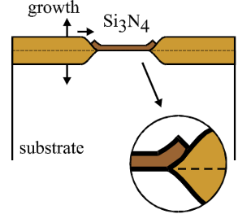
Local Oxidation
The presence of another material such as silicon nitride (Si₃N₄) on the surface inhibits the growth of oxide in that region
This allows selective or local oxidation of the substrate surface - will be used to isolate devices or conductive layers
Some oxidation does occur laterally under the nitride layer, giving rise to the bird’s beak effect

Slide 24
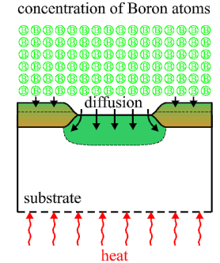
Dopant Diffusion
Dopant can be introduced into the substrate through diffusion
Diffusion is a general physical process which drives particles down a concentration gradient
The substrate is heated in the presence of dopant atoms, which then diffuse into the substrate
Diffusion may also occur into other layers which are present such as silicon dioxide
Large amount of lateral diffusion also occurs

Slide 25
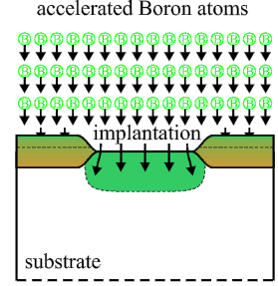
Ion Implantation
In ion implantation, dopant atoms are accelerated toward the substrate surface and enter due to their kinetic energy
This is the preferred technique for introduction of dopant atoms since the amount of lateral diffusion is much lower

Slide 26
Deposition
Layers of materials such as metal (and in some cases silicon dioxide) may need to be formed on the surface
General procedure of forming a layer of material on the surface is termed deposition
Two types can be identified, physical and chemical
In physical deposition, a piece (target) of the material to be deposited is bombarded with ions, ejecting atoms of material which then adhere to the substrate surface
Chemical deposition uses an ongoing chemical reaction to form the desired material as a precipitate on the substrate surface
A specialized form of deposition is epitaxy, the formation of a layer of crystalline semiconductor material

Slide 27
Patterning
The use of a series of PR deposition, exposure, development and etching to create regions of particular shape is called patterning
For example, if a newly deposited metal layer was coated with PR, exposed using a mask, developed and etched using a method which selectively removed the metal not covered by the PR, this would be referred to as “patterning” the metal
There will be many individual patterning steps in the creation of a useful integrated structure

Slide 28
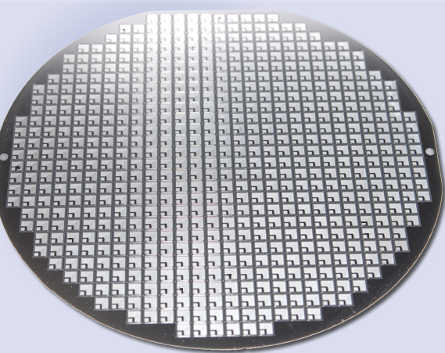
Fabricated wafer

Slide 29
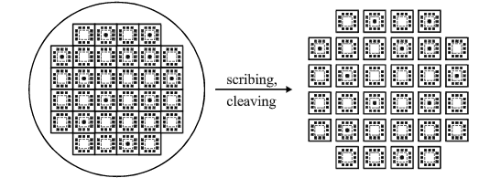
Scribing and cleaving
After processing is finished, the wafers are separated into individual dice by scribing and cleaving
Scribing refers to creating a groove along scribe channels which have been left between the rows and columns of individual chips (during mask generation)
Cleaving is the process of breaking the wafer apart into individual dice

Slide 30
Question!!!

